Slide 1
Azure Platform as a Service (PaaS)

Slide 2

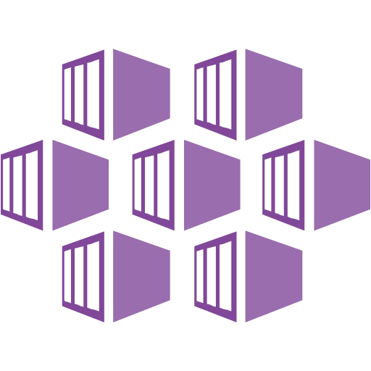





Topics Explored
Azure PaaS
PaaS Compute
Serverless
Containers
PaaS Networking & Hybrid
Messaging
Databases & Data stores
DevOps, Monitoring
DevOps automation
Monitoring PaaS solutions

Slide 3
Agenda
Technical Briefing - Azure PaaS
Whiteboard Design Session: Modern Cloud Apps
Technical Briefing - DevOps
Whiteboard Design Session: Continuous Delivery in Azure DevOps

Slide 4


Azure PaaS
PaaS Compute
Serverless
Containers
PaaS Networking & Hybrid
Messaging
Databases & Data stores

Slide 5
PaaS Compute

Slide 6
From infrastructure to innovation
INNOVATION
VALUE TO BUSINESS
PaaS
APPLICATIONS AND SERVICES
EFFICIENCY
IaaS
TIME

Slide 7
Advantages of PaaS
Faster time to market
Reduced coding time
Efficiently manage application lifecycle
Notes:
Faster time to market – managed VMs and reduced management overhead lead to less infrastructure to manage and configure
Reduced coding time – built-in features in the platform (such as workflow, directory services, security features, search, and more) reduce the time it takes to code apps
Efficiently manage application lifecycle – PaaS provides capabilities needed to support the complete web application lifecycle; including build, test, deployment, management, and updates within the same integrated environment
RESOURCES:
https://azure.microsoft.com/en-us/overview/what-is-paas/

Slide 8
Azure App Service
Easily build powerful web apps and APIs
Take control with fully managed platform
Host apps with confidence
Notes:
Easily build powerful web apps and APIs
Use popular frameworks including .NET, .NET Core, Java, Node.js, Python, PHP, and Ruby. Deploy them in containers or as code, running on Linux or Windows. Use a fully managed platform that provides management, monitoring, and operational insights to meet rigorous, enterprise-grade performance, security, and compliance requirements. Get unparalleled developer productivity with advanced capabilities such as continuous integration, live-site debugging, and Microsoft Visual Studio and Visual Studio Code IDEs. Tap into prebuilt apps from the Azure Marketplace.
Take control with a fully managed platform
Run and scale your web apps on Windows or Linux using a fully managed platform to perform infrastructure maintenance, load balancing, and more—all with zero-downtime deployments. Connect your apps to SQL or NoSQL databases, in Azure or in your own datacenter. Easily add custom domains, SSL certificates, single sign-on (SSO), and identity-service integration to your apps. Get detailed performance and application health insights for accelerated troubleshooting.
Host your apps with confidence
App Service offers an enterprise-grade global datacenter network. Connect your web or mobile apps to enterprise systems or SaaS in minutes. Secure them with Azure Active Directory (Azure AD) integration, and deploy them in the environment of your choice—public cloud, private cloud, virtual network, or on-premises. Easily set up and run apps at scale in the isolated, compliant, and dedicated Azure App Service Environment. Get more secure, high-speed connections to on-premises corporate resources and other Azure resources, and maintain fine-grained control over network traffic.
RESOURCES:
https://azure.microsoft.com/en-us/services/app-service/

Slide 9

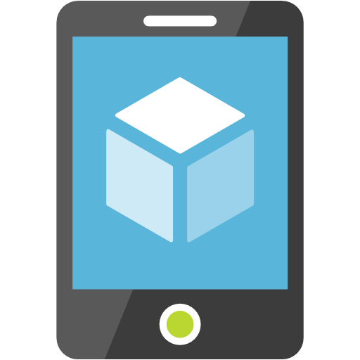
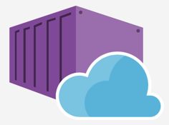

Azure App Service
Web Apps
Web apps that scale with your business
Mobile Apps
Build mobile apps for any device
Web App for Containers
Serverless event based development accelerator
API Apps
Easily build and consume APIs in the cloud

Slide 10
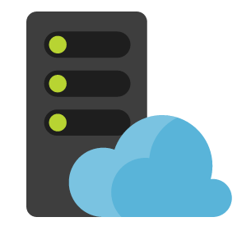
App Service Plans
App Service Plans represent a set of features and capacity that you can share across your web apps
You can have multiple plans to support deployments of separate tiers of feature and capabilities
Web App
Web App
…
App Service Plan

Slide 11

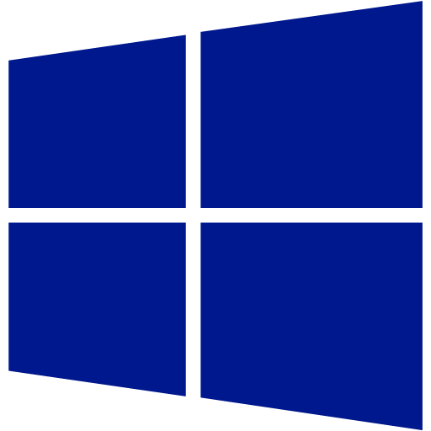
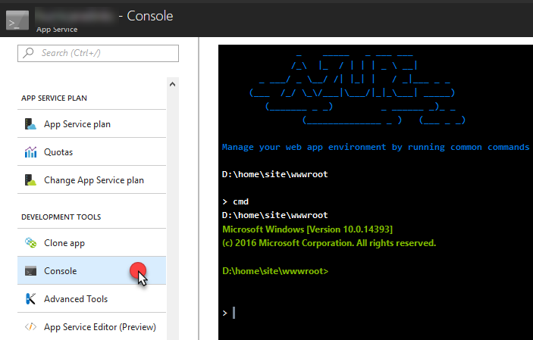
Web Apps on Windows
Microsoft managed VM
Windows Server 2016
IIS 10
Updates applied automatically
No Remote Desktop support
Console via Azure portal

Slide 12

Web Apps on Linux
Microsoft managed VM
Ubuntu Server
Different Images based on Runtime stack / container selected
Updates applied automatically
SSH Support via Azure Portal
Multiple Runtimes supported
Ruby, Node.js, PHP, .NET Core

Slide 13
Web Apps on Containers
Microsoft managed VM (Ubuntu Server)
Supports Custom Docker containers, via Azure Container Registry, Docker Hub or Private Registry
Run Docker Container in App Service Web App
SSH Support via Azure Portal

Slide 14
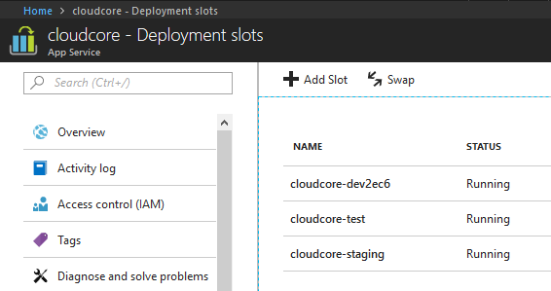
Deployment Slots
A separate web site linked to your primary web site
Each deployment slot has it’s own URL and runtime environment
https://cloudcore-test.azurewebsites.net
Notes:
Each Web App allows you to add multiple Deployment Slots. The number of deployment slots that can be created is dependent on the App Service pricing tier. Each Deployment Slot will have it’s own URL and runtime environment. However, all Deployment Slots are linked to the Production or Primary Web App Deployment Slot, and is hosted on the same underlying, managed VM.

Slide 15





Update web apps with Minimal Downtime
http://cloudcore-dev.azurewebsites.net
http://cloudcore-staging.azurewebsites.net
http://www.cloudcore.com
4. Swap to Staging (Production Environment) for final validation
5. Swap to production web site
2. Code is built and deployed to deployment slot
Dev/Test
Staging
Production
1. Developer checks code in
3. Test validates quality using test environment
Notes:
Using deployment slots we are able to update web apps with minimal downtime. Deployment slots are live web apps with their own hostnames. Web app content and configurations elements can be swapped between two deployment slots, including the production slot.

Slide 16
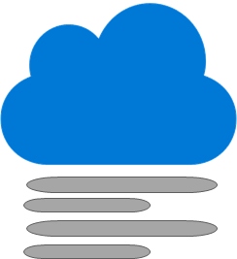
Traffic Routing and Deployment Slots
Traffic routing directs a portion of traffic to an alternate slot
Test new updates
Gradual ramp-up of new site
A/B testing
Production Site
90%
10%
Test Site
Notes:
Discover functional bugs or pinpoint performance bottlenecks in your updates prior to site-wide deployment
Perform "controlled test flights" of your changes by measuring usability metrics on the beta app
Gradually ramp up to a new update, and gracefully back down to the current version if an error occurs
Optimize your app's business results by running A/B tests or multivariate tests in multiple deployment slots

Slide 17
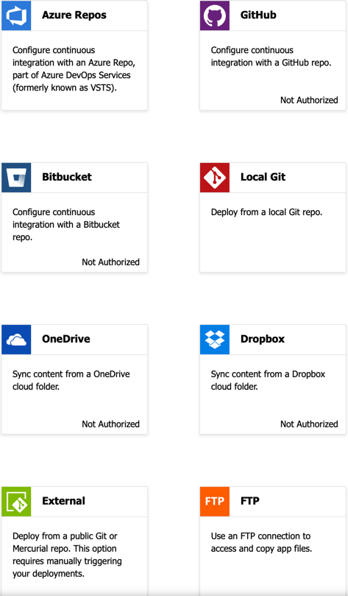
Deployment Center
Publishing Code from Source Control
Typically to a non-production Slot
Continuous Delivery from GitHub, BitBucket, and Azure Repos

Slide 18
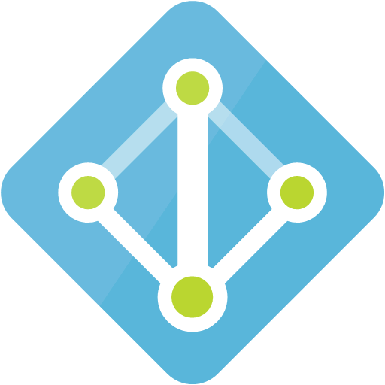

Controlling Access to Azure Services
Enable Multi-Factor Authentication
Manage role based access control using Azure AD Groups
Use least privileged role necessary for task
Create custom roles as needed

Slide 19





App Service Environment
Fully Isolated and dedicated PaaS environment
Run App Service apps a high scale
Can host Windows Web Apps, Linux Web Apps, Containers, and Functions
Allows for high memory utilization
Scales vertically and horizontally making for idea large stateless applications
Worker Pool
App Plan P1
Worker Pool
App Plan S1
Worker Pool
App Plan P3

Slide 20
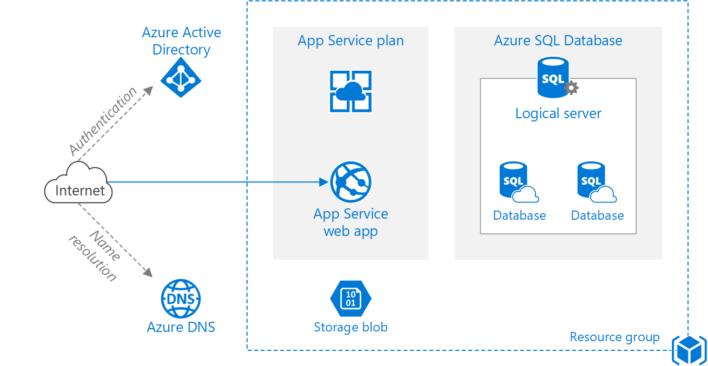
Architectures: Basic Web Application

Slide 21
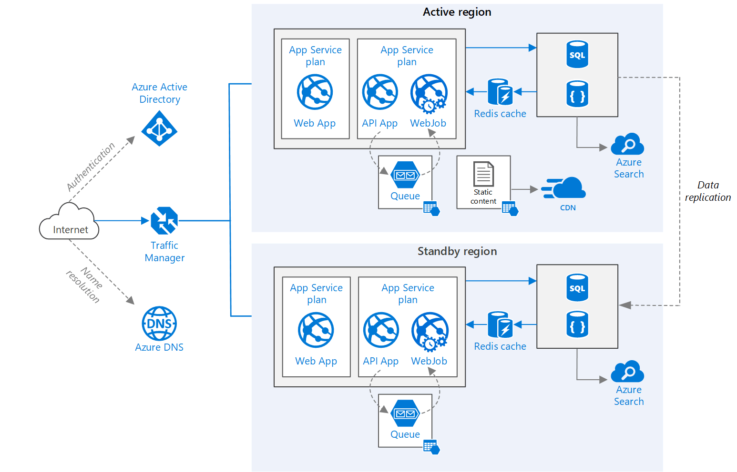
Architectures: Multi-region deployment

Slide 22
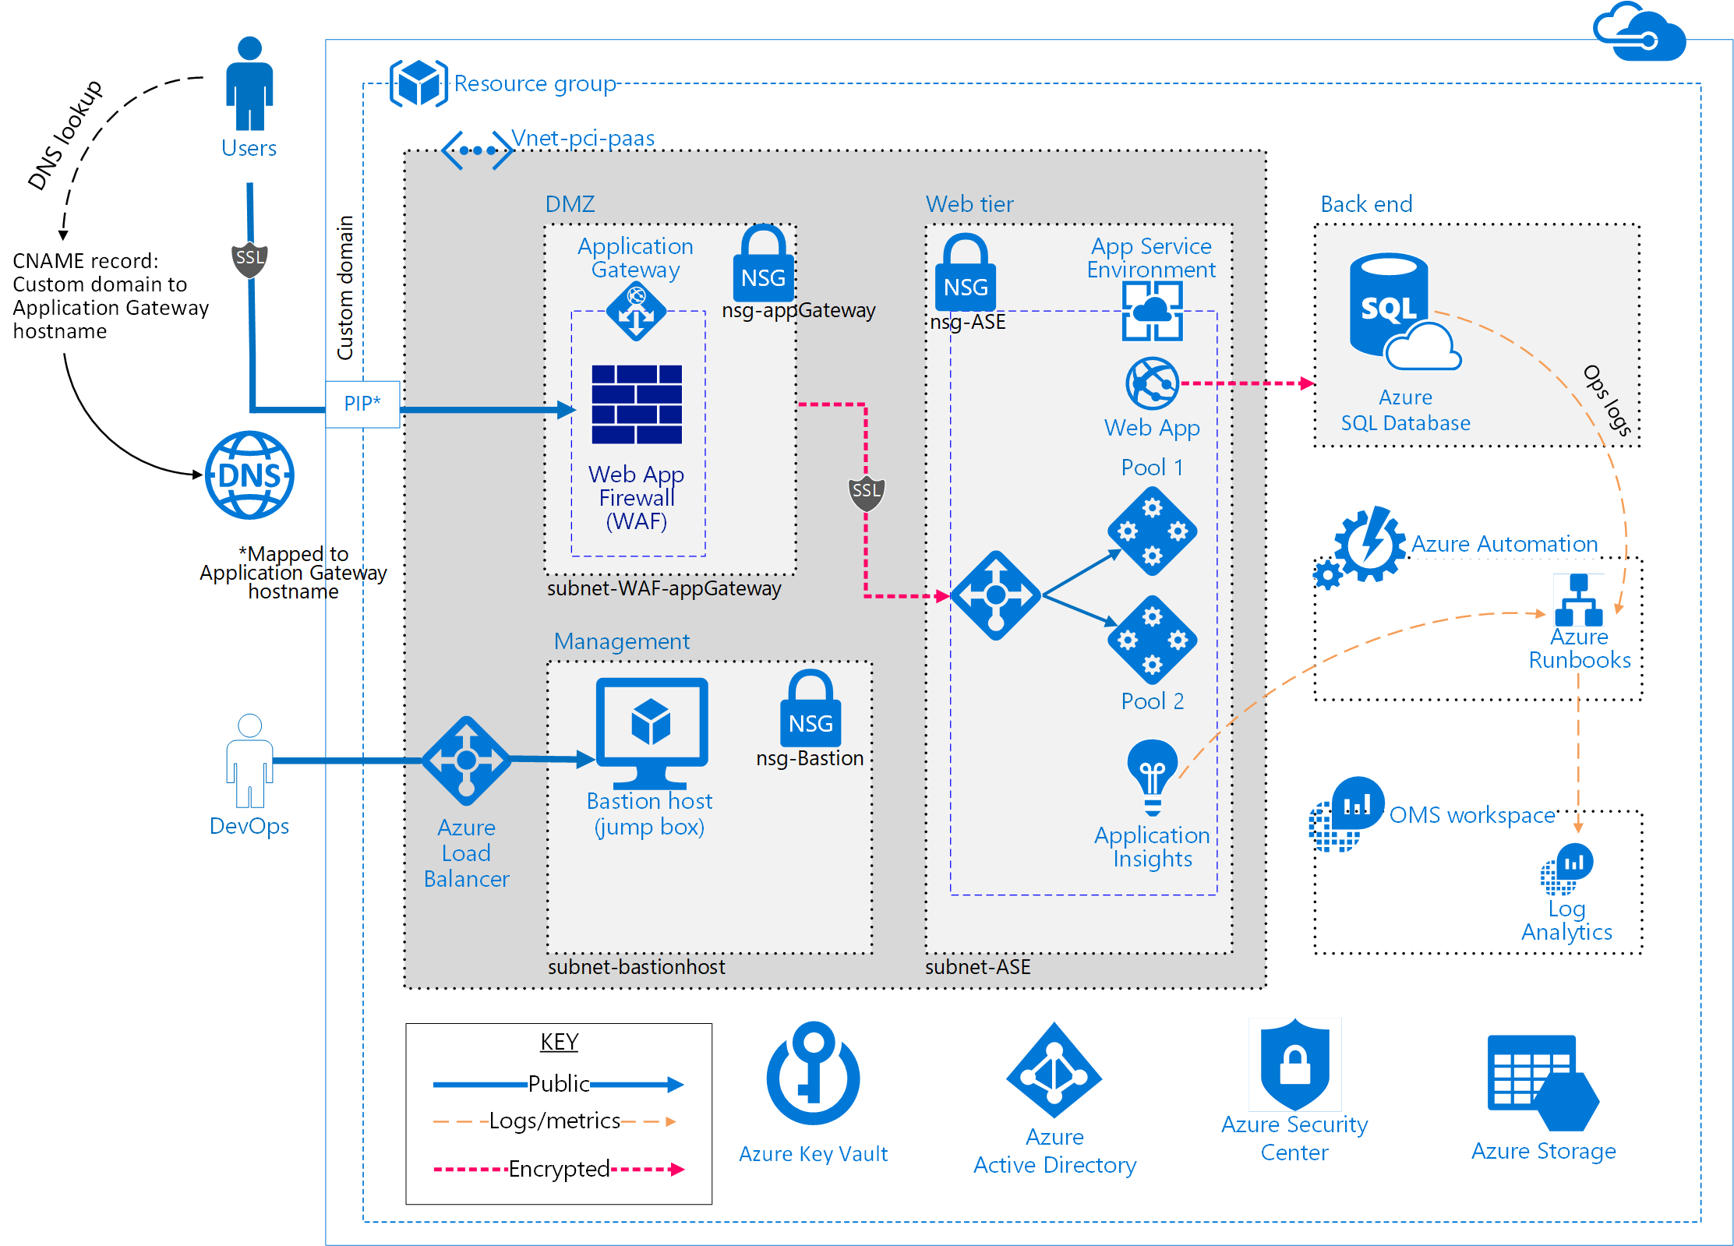
Architecture: Azure App Service PCI Compliant

Slide 23
Discussion Point
What to you see as the advantages of using App Service and PaaS verus using IaaS VMs?
Do you think that Microsoft has finally arrived at a solution that teams will embrace in terms of PaaS now that there is support for Windows, Linux and Containers?

Slide 24
Serverless

Slide 25
Benefits of “Serverless”
“Pinnacle of PaaS compute”
Not just hardware “servers”, but software servers are also managed for you
Focus on business logic, not solving technical problems not core to business
Lower effort to get started makes it easier to experiment (bots, etc.)

Slide 26
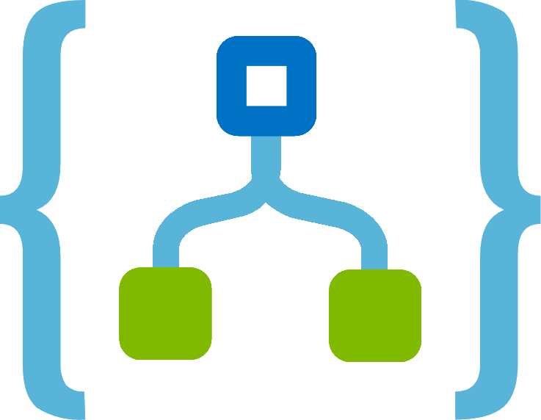
Azure Serverless Platform
Azure Functions
Azure Logic Apps
Custom Code
Developer productivity
Triggers and Bindings
Flexible deployment options
Workflow & Integration
Visual designer
100+ connectors
Functions orchestration
Notes:
The two main Serverless compute services within Microsoft Azure are Azure Functions and Azure Logic Apps. {cover bulleted details of slide for each}
RESOURCES:
https://azure.microsoft.com/mediahandler/files/resourcefiles/azure-functions-serverless-platform-security/Microsoft%20Serverless%20Platform.pdf

Slide 27

Azure Functions
Dual Abstraction
Serverless compute abstracts away the compute
Bindings abstract away the services code interacts with to provide result of the code execution
Other Services
Business Logic
Serverless PaaS

Slide 28
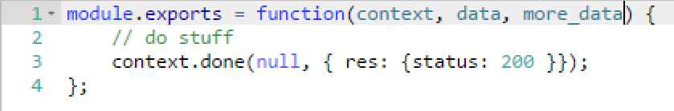
Azure Functions
Trigger
Input
Code
Output

Slide 29
Azure Logic Apps
Quickly build powerful integration solutions
Create business processes and workflows visually
Integrate with SaaS and enterprise applications
Unlock value from on-premises and cloud applications
Create enhanced integration solutions

Slide 30
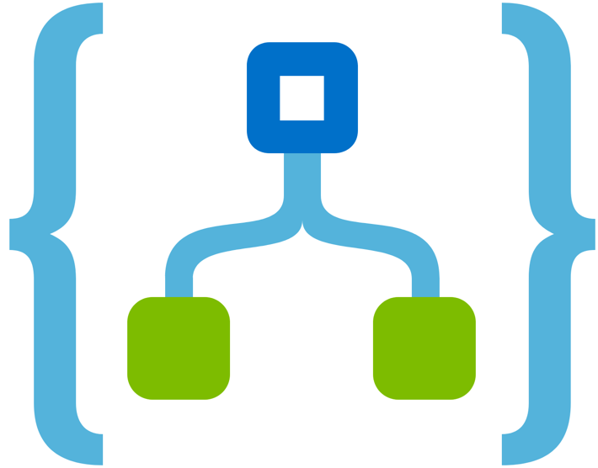


Azure Functions – Event Integration
Example: Invoice Processing
API Management
Logic App
Azure Function
Post new invoice
Convert to JSON
Grab raw file
Store record
API layer
Azure Function
Fetch Invoice

Slide 31
Azure Functions - Pricing
App Service Plan
Based on App Service Plan (dedicated resources)
Multiple Function Apps and/or Web Apps can share the same plan
Consumption Plan
Serverless Compute
Only pay for what you use (GB/s)

Slide 32
Discussion Point
What are the advantages of moving to a Serverless model?
Have you seen/heard of customers adopting stateless applications in discussions with clients or your peers?

Slide 33
Containers

Slide 34

Containers
Shipping containers are efficiently moved using different modes of transport
Exact same dimensions & strength
Initially being carried by a truck to a port
Stacked alongside thousands of other containers on a huge container ship
Ship carries them to the other side of the world
At no time during the journey does the container need to opened, repacked or modified in any way to reach its destination

Slide 35
Compare: Containers to VMs
VM
Container
App A
App B
App C
App A
App B
App C
Bins/Libs
Bins/Libs
Bins/Libs
Bins/Libs
Bins/Libs
Bins/Libs
Guest OS
Guest OS
Guest OS
Docker
Hypervisor
Host OS
Infrastructure
Infrastructure
Virtual Machines
Containers

Slide 36
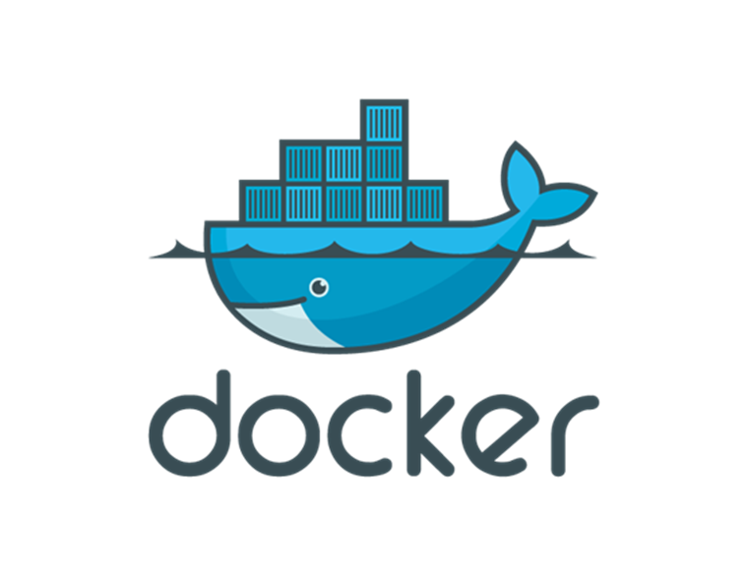
What is a container?
Container is comprised of all components to run the application
Lighter weight than VMs
Predictable execution regardless of where it’s deployed.

Slide 37
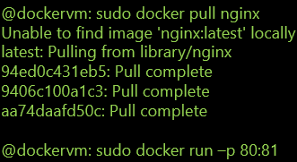


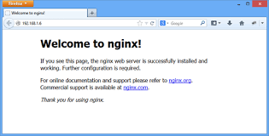
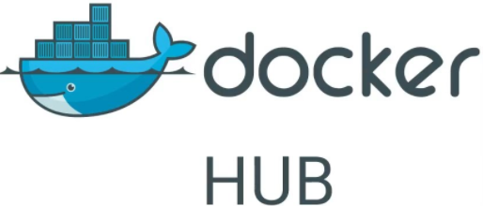
Using Docker Images: Linux
Image is “pulled” from the Registry
docker pull nginx
Container started using “Run”
Software accessible once container is started
TCP Ports mapped between Container and HOST
docker run nginx –p 80:81
1
Image Pulled
From Docker Hub
NGINIX Container Up on Port 81
2
Notes:
Here we see the workflow that is very typical for starting a container on Linux.
<click>
A docker pull command is issued with the name of the image. This will pull the image local to the machine.
<click>
The run command is then issued with a reference to that image that was pulled down and with arguments. Here we see the nginx web server image running on a machine and the -p command has been used to map the port where the web server will be running.

Slide 38
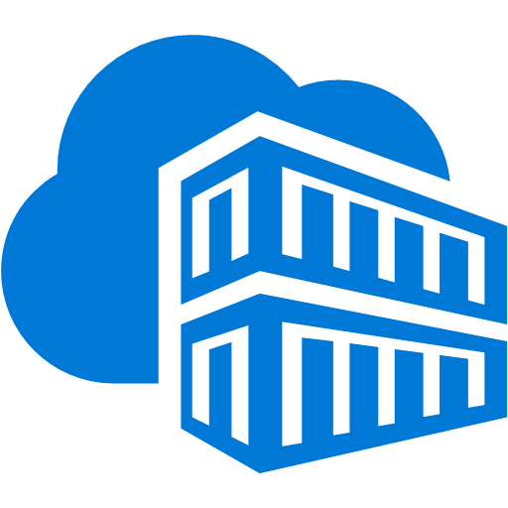
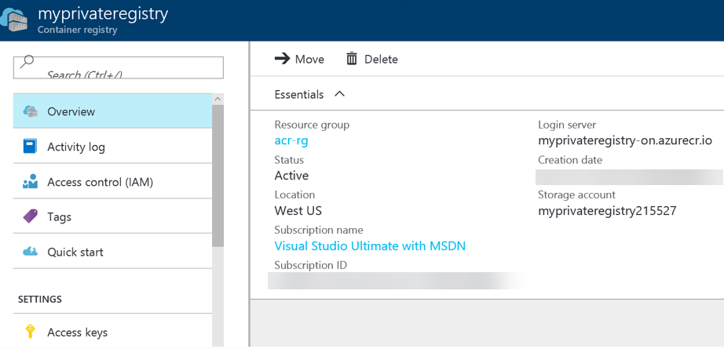
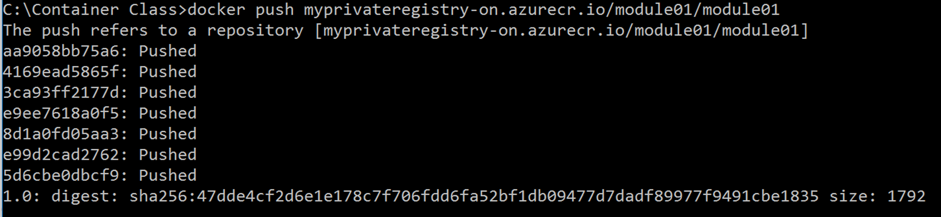
Azure Container Registry
Docker Private Registry hosted in Azure
Store and manage container images across all types of Azure deployments
Keep container images near deployments to reduce latency and costs
Maintain Windows and Linux container images in a single Docker registry
Use familiar, open-source Docker command line interface (CLI) tools
Simplify registry access management with Azure Active Directory
Notes:
The Azure Container Registry is the perfect solution to publishing and maintaining docker images in Azure. Read the bullets.

Slide 39
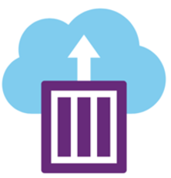
Azure Container Instances
Start a container in seconds with a single command without VMs
Pull container images from Docker Hub or Azure Container Registry
Containerize your application using Docker technology and execute immediately with one click
Take advantage of per-second billing & container-based compute on demand
Notes:
Azure Containers are a super easy and fast way to run containers in Azure. This doesn’t require ACS or even IaaS VMs. These can be started in just a few seconds.

Slide 40
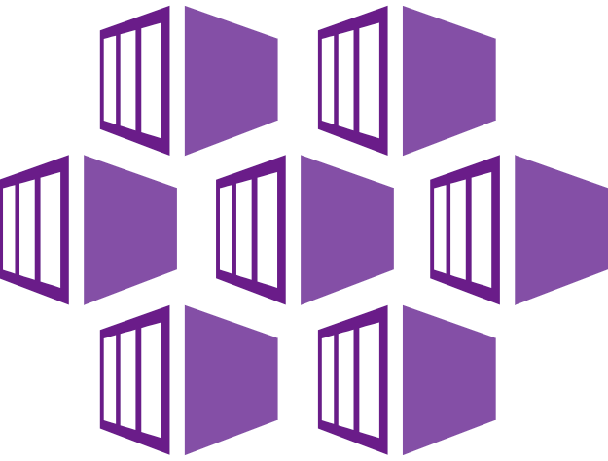
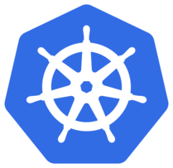
Azure Kubernetes Service (AKS)
Fully managed Kubernetes service / Serverless Kubernetes
Manage Kubernetes with ease
Accelerate containerized application development
Run any workload in the cloud, at the edge, or as a hybrid
Notes:
RESOURCES:
https://azure.microsoft.com/en-us/services/kubernetes-service/

Slide 41
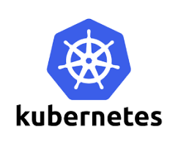

Kubernetes
High Level Components
Master
Defines the Cluster and Managing the resources including the Storage, Scheduler & API Endpoint
Manages Registries of various pieces of the cluster (Nodes, Services, Pods)
Nodes
Provides the compute power
Pods run on Nodes
Collection of Containers that can run on a host
Logical Host with access to a shared volume
Service
Defines Set of Pods to be used for a Service
Container
Unit of Compute
node1
pod1
pod2
master
service 1
{pod4}
Storage
node2
pod3
pod4
Containers run in Pods as defined by a Service
1
2
3
Notes:
<click>
Let’s first look at the High-level components. The Master defines the cluster, storage, scheduling etc. It also manages the registries and various pieces of the cluster.
<click>
Next of course is some storage component that provides the volume of disk required to support the containers and the cluster.
<click>
The nodes then provide the compute power for the cluster.
<click>
Pods run on these nodes and they are a collection of containers that can run on a host and this ultimately is a “logical host” to the application that was defined to run within the pod. It has the access to the compute power of the nodes as well as the storage provided by the nodes.
<click> A service defines the set of posts to be used for a given service.
<click>
The containers then run on the pods as defined by the service meaning which images run and with the parameters that make sense for the application deployment.

Slide 42
Discussion Point
Do you feel like you can explain the basics of containers?
Why are they important?
Have you seen customers used K8s or another container orchestrator in production?

Slide 43
PaaS Networking & Hybrid

Slide 44

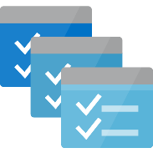
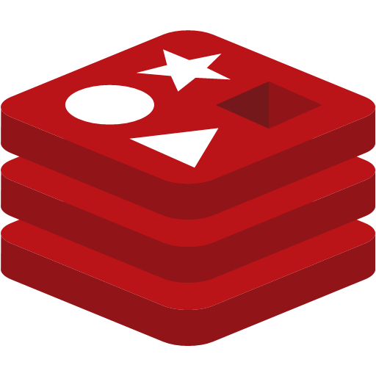
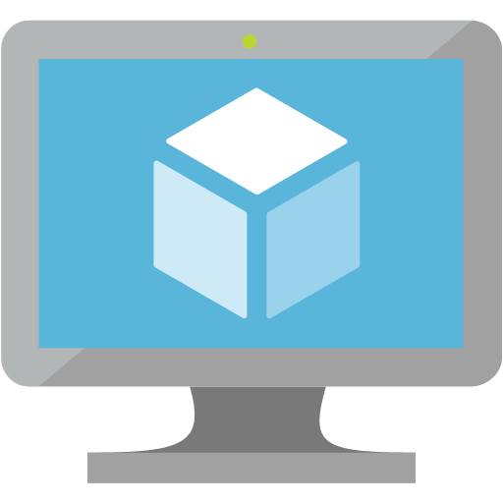


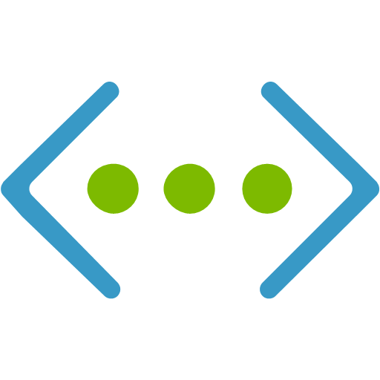
VNET PaaS Service Integration
Dedicated PaaS
Customer dedicated PaaS Services deployed to VNETs
Service Tunnel security connects customer VNET to multi-tenet PaaS services
HDInsight
Batch
App Service
RedisCache
Deploy
Customer VNET
Multi-Tenet PaaS
Storage
Service Tunnel
ACL
SQL DB
SQL DW
Notes:
Key talking points: VNET Pass Server Integration allows for the deployment of PaaS service instances into a customer VNET and secured tunnel connections between PaaS services and customer VNETs. This means better security and Isolation for these services allowing for better compliance and adoption by enterprises.

Slide 45
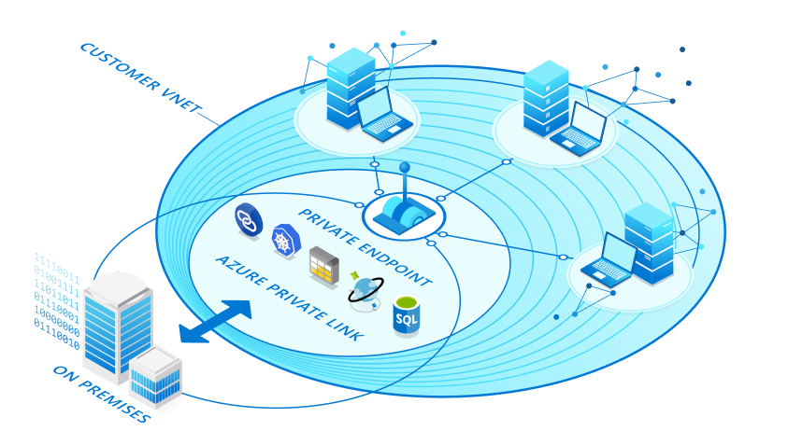
Private Link
Azure Private Link provides private connectivity from a virtual network to Azure platform as a service (PaaS), customer-owned, or Microsoft partner services
Secures the connection between endpoints in Azure by eliminating data exposure to the public internet

Slide 46
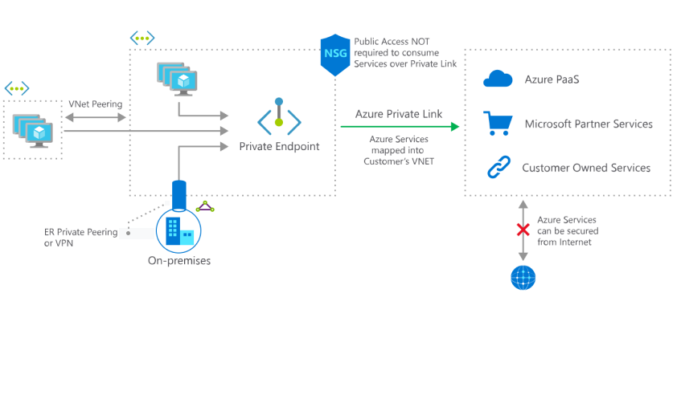
Private Link

Slide 47
Messaging

Slide 48
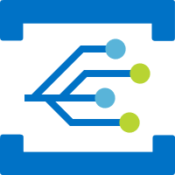


Messages in Azure
Event Grid
Azure offers three services to assist in delivering events messages
Event Hub
Service Bus

Slide 49
Important distinction in Type
Event
Message
lightweight notification of action / state change
Contains metadata of the Event
Example
Notification that a file was changed
Raw data sent from one service to another
Contains the data being sent
Examples
E-commerce order needs to be fulfilled
Application telemetry sent for logging
Publisher may expect a response message back after processing

Slide 50
Event / Message Services
Service Bus
Reliable Message processing for Enterprise applications
Store messages in one or more queues until they are processed
Event Hub
Highly scalable event ingestion service
Front door to a Big Data event processing pipeline
Event Grid
Event backplane, enabling event-driven application architectures
Built for serverless event processing

Slide 51
Comparing the three
Purpose
Type
When to use
Event Grid
Reactive programming
Event distribution
React to status changes
Event Hub
Big data pipeline
Event streaming
Telemetry and distributed data streaming
Service Bus
High-value enterprise messaging
Message
Order processing and financial transactions

Slide 52
Databases & Data stores

Slide 53
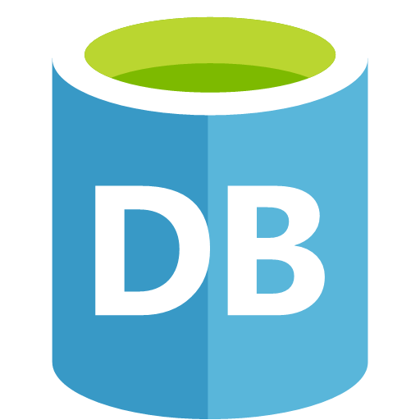

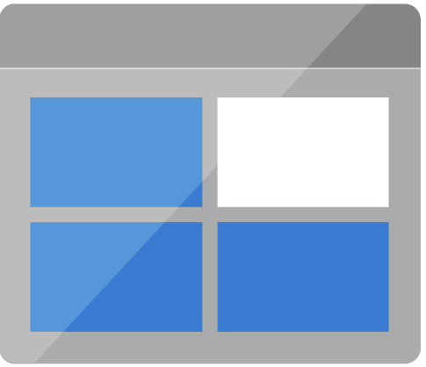


Storage Options
Relational Database (RDBMS)
NoSQL
Key-Value
Document
Graph
Column
Message Queues
Object Storage / File Storage

Slide 54

Azure Storage
Blobs
Highly scalable, REST based cloud object store
Block Blobs: Sequential file I/O
Cool Tier Available
Page Blobs: Random-write pattern data
Append Blobs
Disks
Persistent disks for Azure IaaS VMs
Premium Storage Disks option: SSD based, high IOPS, low latency
Files
Fully Managed File Shares in the Cloud
SMB and REST access
“Lift and shift” legacy apps
Synch with on-premises (New!)
Tables
Massive auto-scaling NoSQL store
Dynamic scaling based on load
Scale to PBs of table data
Fast key/value lookups
Queues
Reliable queues at scale for cloud services
Decouple and scale components
Message visibility timeout and update message to protect against unreliable dequeuers
Azure Storage Technologies typically leveraged for Applications
Built on a unified Distributed Storage System
Durability, Encryption at Rest, Strongly Consistent Replication, Fault Tolerance, Auto Load-Balancing

Slide 55





Data at Rest Encryption Options
Storage Account
Storage Service Encryption
Microsoft:
Storage Service Encryption
Automatically encrypts customer data prior to persisting to storage and decrypts prior to retrieval
Microsoft manages encryption keys
Customers:
Azure VMs
Various services offer additional capabilities for securing data at rest
PaaS
Azure SQL Database supports TDE
Applications
Client Side encryption through .NET Crypto API
RMS Service and SDK for file encryption by your applications
Virtual Machines
SQL TDE
Bitlocker
Partners
PaaS
SQL DB TDE
Applications
.NET Crypto
RMS SDK

Slide 56


Controlling Access to Azure Storage
Stored Access Policies
Supports revocation
Expiration Date
Permissions (Write, Read, Delete, List)
Not supported for Account SAS
Azure Storage Best Practices
Rolling keys updates
Implement Shared Access Signatures (SAS)

Slide 57
Azure Storage Service Encryption
Service Encrypts Data Automatically using Microsoft Managed Keys
Blobs, Tables, Files, and Queues
Transparent encryption using AES 256-bit cipher
Can also bring your own keys

Slide 58
Azure SQL Database
Delivers Database-as-a-Service functionality, based on SQL Server and hosted in Microsoft Azure
Predictable performance, scalability, business continuity, elastic scale, data protection, minimal administration, and familiar tools

Slide 59
Controlling Access to Azure SQL DB
Firewall rules
Server level rules apply to all databases on the server even if they have database firewall rules
Database level rules are database specific and are stored within the database and are maintained across geo-replication
Server rule “Allow Azure Services” allows for any connection coming from Azure, even from other subscriptions
Notes:
Now we’ll transition to a discussion of Azure SQL Database, a DBaaS service available in Azure that is based on Microsoft SQL server. When you create an Azure SQL DB, you create two entities. The first is a SQL Server and the second is the actual database. The SQL server definition allows for the construction of connection strings and also manages security settings, such as the SQL firewall. You can provision both server-level rules, which grant or deny access to all databases on the server, or database-level rules. A special server-level rule to be aware of is the “Allow Azure Services” rule, which allows all Azure PaaS services to access the Azure SQL DB instance.

Slide 60
SQL Database Encryption at Rest
Enable Transparent Data Encryption (TDE)
Data in database files, transaction logs, and backups are encrypted
Keys managed by Azure for low overhead
No application changes necessary
Enable Server-Level Auditing and Threat Detection
Detects anomalous database activities indicating potential security threats to the database
Notes:
Another capability to increase the security of Azure SQL DB is Transparent Data Encryption. Transparent Data Encryption is designed to encrypt data at rest. This includes data in database files, transaction logs and backups. Transparent data encryption requires no changes to you application code or connection strings. Encryption keys are managed by Azure so there is no administrative overhead for enabling TDE.

Slide 61

Cosmos DB
Globally distributed, multi-model database services & Supports all 4 types of NoSQL
Built natively for the cloud
Built for scale
Guarantees single-digit millisecond latencies

Slide 62
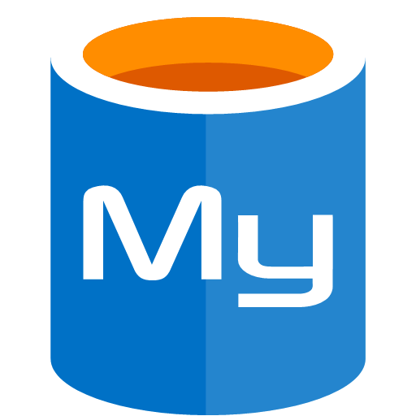
Azure MySQL
MySQL Community Edition
High availability with no additional cost
Predictable performance, using inclusive pay-as-you-go pricing
Scale on the fly within seconds
Secured to protect sensitive data at-rest and in-motion
Automatic backups and point-in-time-restore for up to 35 days
Enterprise-grade security and compliance

Slide 63



Polyglot Persistence
Key/Value Store
User Session
Shopping Cart
File Storage
Product Images / Videos
E-Commerce Website
Multiple instances
Relational Database
Product Orders
Document Database
Product Catalog & Price
Community Posts
Graph Storage
Customer and Product Social Graph
Make recommendations
Background Processing
Pulls data from multiple sources
Notes:
Here’s an example of an E-Commerce system that uses Polyglot Persistence. First, the website is hosted with multiple instances for high availability and scalability reasons. The data used by the system is stored across multiple storage types, each one fits the data it stores best. File Storage is used to store product images and videos that are displayed to users. A Relational Database is used to store Product Orders where transactions and high consistency are needed. A Document Database is used to store Product Catalog information as well as Community Posts, allowing better scaling for a high volume of reads and writes. Then a Key/Value store is used by the Website to provide a much faster mechanism to reading and writing to store User Session and Shopping Cart information that is accessible across all instances of the website. Then a Graph store is used to store a Customer and Product social graph used for making product recommendations. Finally, a Background Processing service also reads and writes from multiple sources.

Slide 64
Discussion Point
How you think customers will perceive Azure’s Data store capabilities?

Slide 65
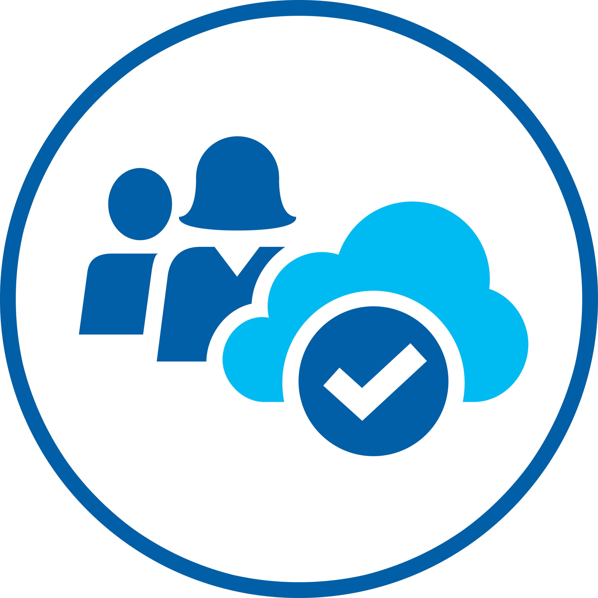
Whiteboard Design Session
Microsoft Cloud Workshop: Modern Cloud Apps
In the whiteboard design session, you will work in groups to design a solution to modernize an e-commerce applications backend and ensure compliance, data privacy and protection across all aspects of the system, in transit and at rest.
The goal is to use Azure PaaS services for the public-facing and back-end websites, while providing a way for the on-premises components to securely communicate with these services. You will also design fault-tolerance and a regional failover plan of the Azure components.
By the end of this whiteboard design session, you will have a better understanding of how to modernize a legacy web app by retargeting it for the cloud, taking advantage of the many services Azure provides to enhance functionality and secure your solution's components by following best practices for PCI compliance and security.
Notes:
https://github.com/Microsoft/MCW-Modern-Cloud-Apps

Slide 66


DevOps, Monitoring & Security
DevOps automation
Monitoring PaaS solutions

Slide 67
Monitoring PaaS Solutions

Slide 68

The challenge of monitoring in the cloud era
“I need to diagnose problems across the app, VMs, networks, and PaaS services.”
“Are we meeting our customer SLAs?”
“How do I understand & optimize performance of my app?”
“Are our customers engaged? Which features are driving engagement?
“It takes me too long to detect & debug the errors in my apps.”
“Is there is a security threat!?!!”

Slide 69
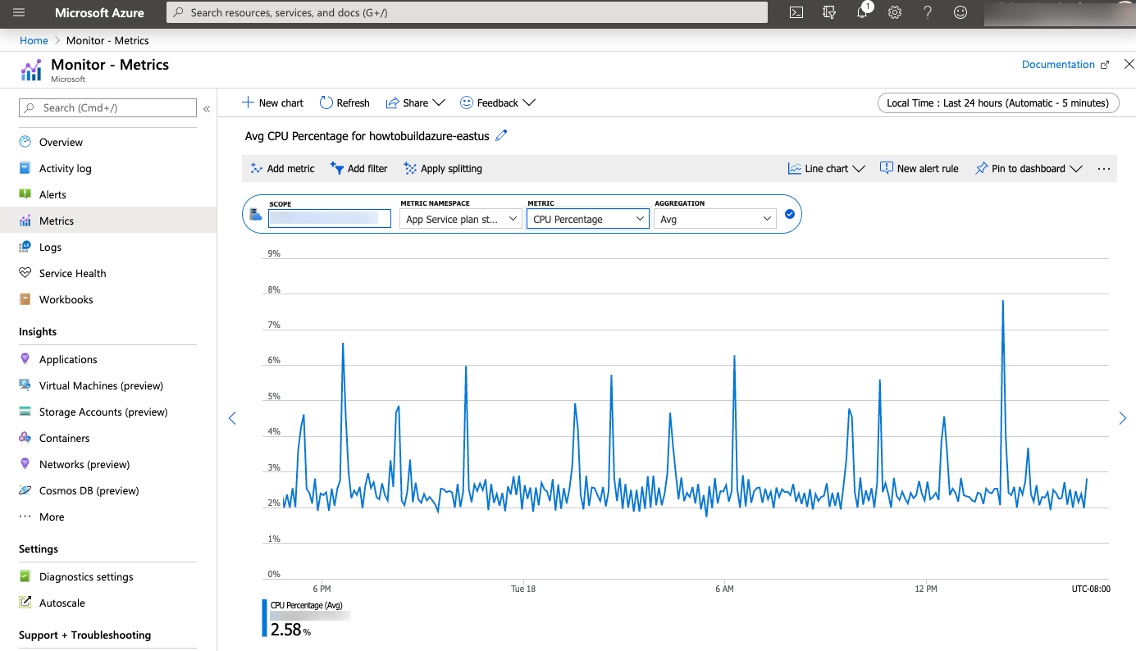
Azure Monitor - Metrics
Notes:
Metrics in Azure Monitor are lightweight and capable of supporting near real-time scenarios making them particularly useful for alerting and fast detection of issues.

Slide 70
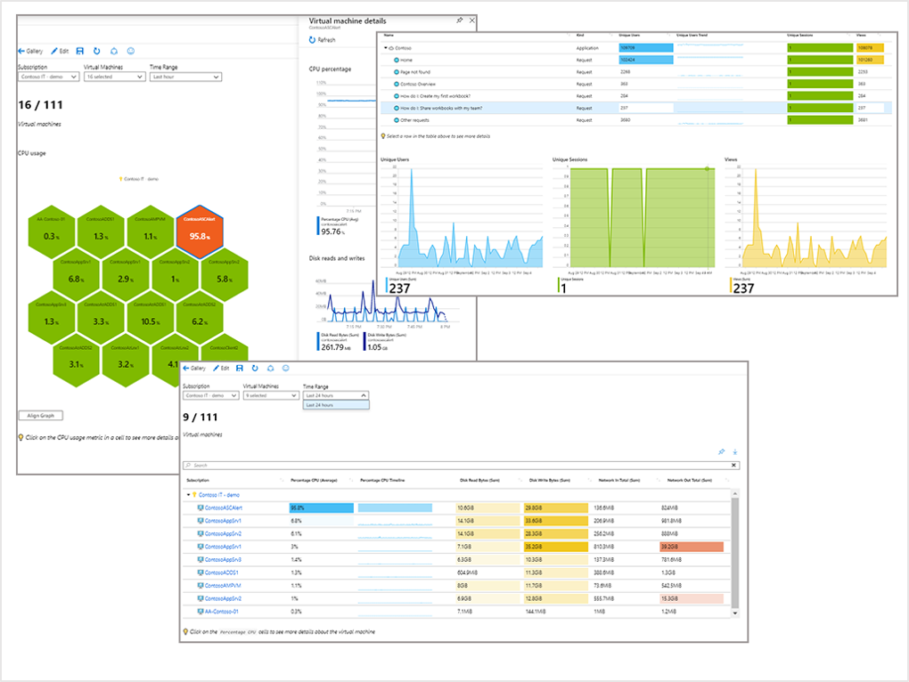
Azure Monitor Workbooks
Workbooks can query data from multiple sources within Azure
Visualize data
Performance
Usage
Health

Slide 71

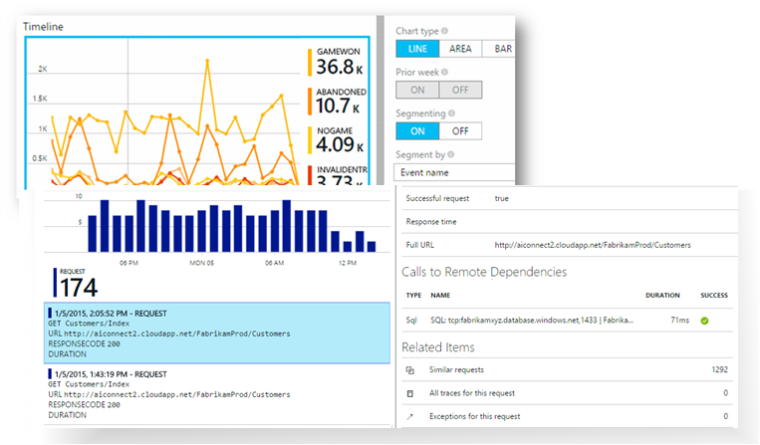
Application Insights
Application Performance Management (APM) service for web developers on multiple platforms
Use it to monitor live web application & automatically detect performance anomalies
Powerful analytics tools to diagnose issues, & discover how users interaction with your app
.NET, Node.js and J2EE, hosted on-premises or in the cloud

Slide 72
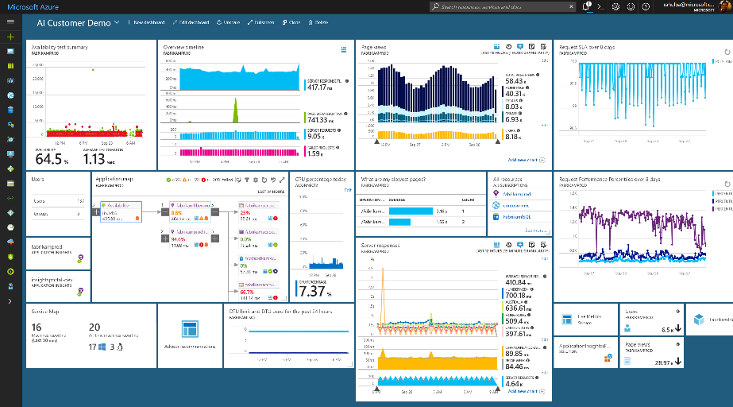
Azure Application Insights
Health Check
Monitor & Optimize
Detect & Debug
ML/Data Analytics
Generate Alerts
Take Actions
Customer Insights
Export & Correlate

Slide 73
Discussion Point
What is the difference between Operations Monitoring and Application Performance Monitoring?
Why is it important to have both deployed for Cloud Applications?

Slide 74
DevOps Automation

Slide 75
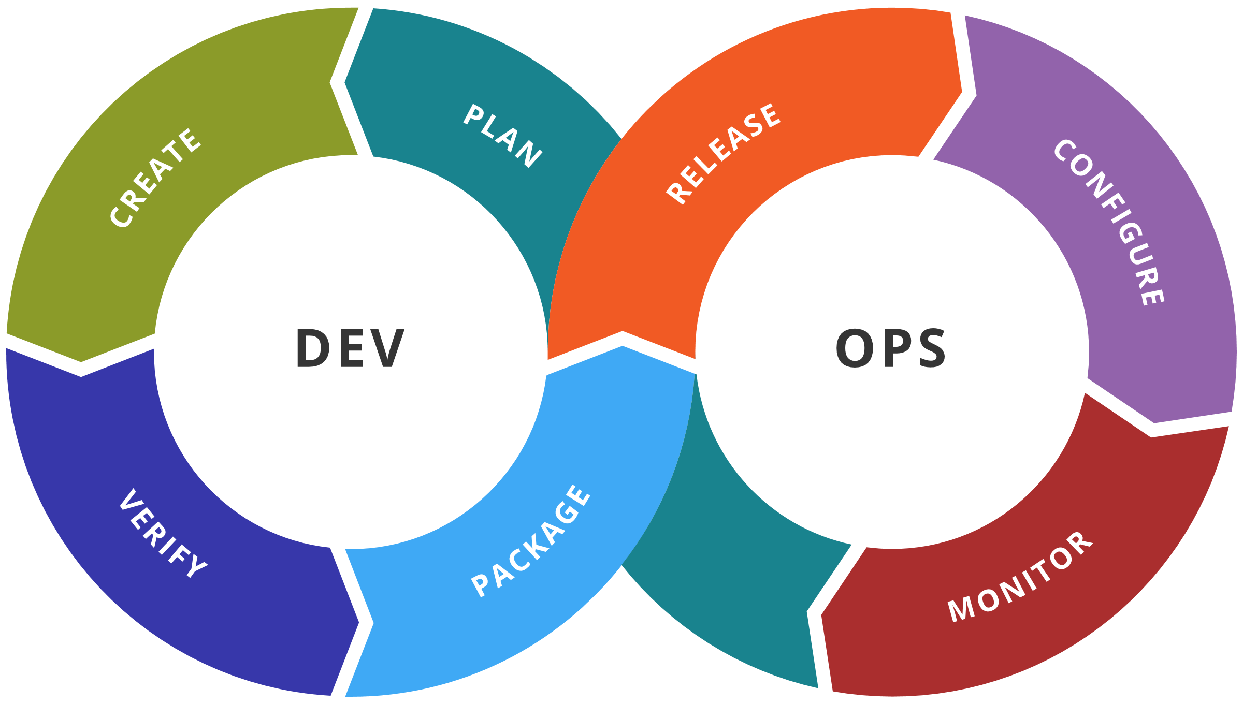
What is DevOps?
DevOps is a combination of Development and information technology Operations, describing a set of practices emphasizing the collaboration between both teams, while automating software delivery and infrastructure changes.

Slide 76


DevOps is the union of people, process, and products to enable continuous delivery of value to our end users.
- Donovan Brown
http://bit.ly/WhatIs-DevOps

Slide 77


High Performance DevOps Companies Achieve…
46x Deployment
Frequency
2,555x Faster Lead
Time For Changes
Faster
Time to Market
DevOps
$
Increased
Revenue
7x Lower Change
Failure Rate
2,604x Faster Mean
Time to Recover
Source: 2018 Accelerate: State of DevOps: Strategies for a New Economy." N. Forsgren, J. Humble, G. Kim. DevOps Research and Assessment (DORA)

Slide 78






DevOps: the three stage conversation
DEV
OPS
1
People
2
Process
3
Products

Slide 79
DevOps Principals
Go faster
Shorten feedback loops
Experiment and learn
Cultural transformation (no finger pointing)
Deliver business and customer value constantly and consistently

Slide 80

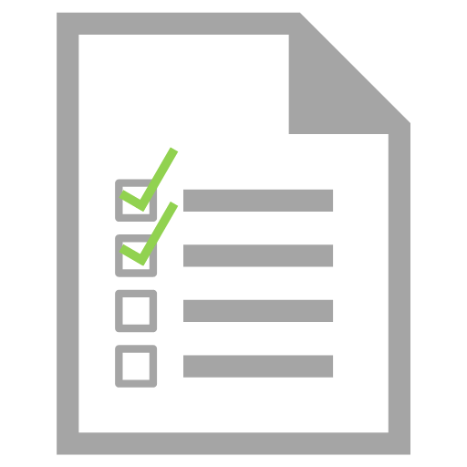
DevOps Dictionary
Development team members integrate their work frequently, usually daily. Each integration is verified by an automated build / test to detect integration errors quickly
Continuous
Integration (CI)
Automated tests are invoked as a crucial step to any automated build process. If tests fail, so does the build
Continuous
Testing

Slide 81

DevOps Dictionary
The full software delivery lifecycle is automated up until the last environment before production
Continuous
Delivery (CD)
One step further from Continuous Delivery, where deployment to production is also automated
Continuous
Deployment (CD)

Slide 82
DevOps Toolchain and Processes
Code
code development, source code management, code merging
Build
continuous integration tools, build status
Test
continuous testing tools that provide feedback on business risk
Package
artifact repository, application pre-deployment staging
Release
change management, release approvals, release automation
Configure
infrastructure config management, infrastructure as code tools
Monitor
applications performance monitoring, end–user experience

Slide 83





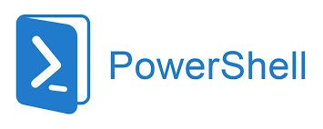

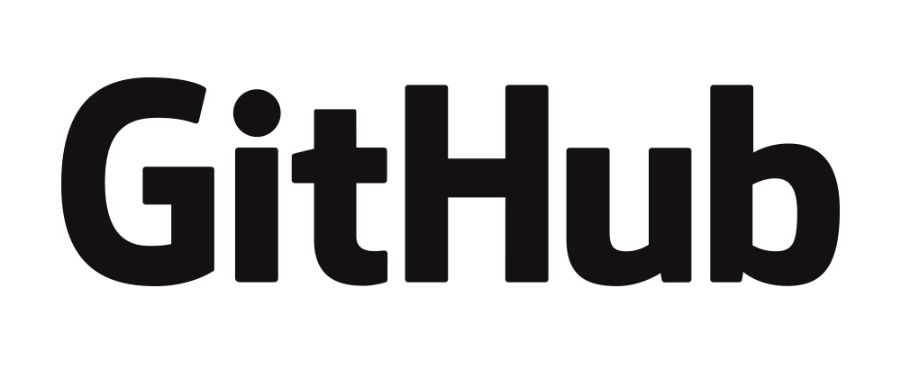
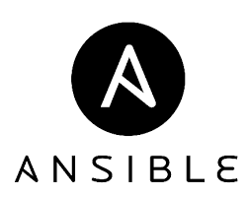

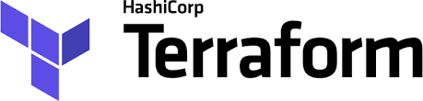
DevOps Tools
Azure
Automation

Slide 84
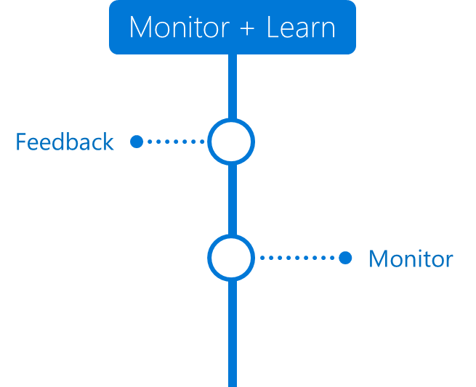
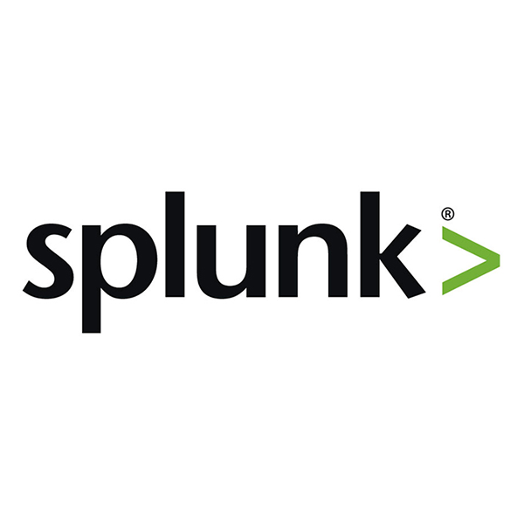





























Any Language
Any Platform
DevOps
DevOps

Slide 85

Architecture: Immutable Infrastructure CI/CD using Jenkins and Terraform on Azure Virtual

Slide 86

Architecture: Continuous integration and deployment (CI/CD) for containers with open-source software (OSS)

Slide 87

Architecture: Container CI/CD using Jenkins and Kubernetes on Azure Container Service (AKS)

Slide 88
Microsoft’s solution
Source control
Azure DevOps Server
Agile planning
Azure DevOps
Test case management
Build automation
Continuous deployment
Release management
Load testing
Lab management
Notes:
RESOURCES:
https://dev.azure.com
https://azure.microsoft.com/en-us/services/devops/server/

Slide 89
Microsoft’s solution
Source control
Azure DevOps
Server
Agile planning
Azure DevOps
Test case management
Build automation
Continuous deployment
Release management
Load testing
Feedback management
Team collaboration
Application telemetry
Lab management

Slide 90




Azure DevOps
Azure Boards
Azure Repos
Azure Pipelines
Azure Test Plans
Azure Artifacts
An end-to-end solution for organizations looking for enterprise-level toolchain
Highly
available,
multi-region,
hybrid cloud
& on-premises
Fully integrated
with end
to end
traceability
Scalable to
any team
and project
size
Consistent
admin
and access
control
Customer
Support
Notes:
RESOURCES:
https://azure.microsoft.com/en-us/resources/videos/getting-started-with-azure-devops/

Slide 91
Automate deployment of VMs
Notes:
modify Azure Resource Manager (ARM) template
configure location of new VMs
configure VHD template
deploy from template
save a deployment as an ARM template
deploy Windows and Linux VMs

Slide 92
Declarative or Imperative
New-AzVm -Name "myVM"
-ResourceGroupName "myRG" `
-Location "East US" `
-VirtualNetworkName "myVnet" `
-SubnetName "mySubnet" `
-SecurityGroupName "myNSG" `
-PublicIpAddressName "myPIP" `
-OpenPorts 80,3389
Imperatively with PowerShell or CLI
az vm create -n WebVM1 -g OpsTrainingOSS_RG -l centralus --size Standard_DS1_V2 --availability-set WebAVSET --nics WebVMNIC1 --authentication-type password --admin-username demouser --admin-password Demo@pass123 --image "Canonical:UbuntuServer:14.04.4-LTS:latest" --use-unmanaged-disk --os-disk-name WEBVM1-OSDISK.vhd --storage-account clistorage101 --storage-container-name vhds
{
"type": "Microsoft.Compute/virtualMachines",
"apiVersion": "2018-10-01",
"name": "[variables('vmName')]",
"location": "[parameters('location')]",
],
"properties": {
"hardwareProfile": {
"vmSize": "[parameters('vmSize')]"
},
Declaratively define using a template
Notes:
When working with Azure scripting you can use either imperative PowerShell Cmdlets or Azure ARM templates.
When working with PowerShell you are “Asking” to do something on your behalf and providing some inputs.
With Azure ARM templates you are specifically telling Azure what, how and where do builds or change your Azure resources.

Slide 93

VS Code ARM
Work with ARM Templates using the Azure Resources Manager Tools with IntelliSense
Function Names
Parameter References
Properties
Provides language support for Azure Resource Manager deployment templates and template language expressions
Integrated Terminal for PowerShell or Azure CLI deployments

Slide 94

ARM Templates, Infrastructure as Code (IAC)
Used by Admins to provision an Azure Infrastructure using a Programing Language
The Code tells Azure “What to Build”

Slide 95


One ARM template to rule them all…
Used to store settings specific to an environment
Could be used to document different types of environments details, but identical resources
Use Variable Groups instead of parameters files to build environments
azure-deploy.json
Dev
Test
Prod
parameters.json
dev
test
prod

Slide 96
Template Advantages
Improves consistency
Express complex deployments
Reduce manual, error prone tasks
Express requirements through code
Promotes reuse
Modular and can be linked
Simplifies orchestration
ARM
Template
Development
Production
Quality
Assurance
Notes:
Use the same template across deployments so the resources are identical.

Slide 97
Template Schema
Defines all the Resource Manager resources in a deployment
Written in JSON
A collection of key-value pairs
Each key is a string
Each values can be a string, number, Boolean expression, list of values, object
{
"$schema": "http://schema.management.
azure.com/schemas/2015-01- 01/deploymentTemplate.json#",
"contentVersion": "",
"parameters": { },
"variables": { },
"functions": [ ],
"resources": [ ],
"outputs": { }
}

Slide 98
Template Parameters
Specify which values are configurable when the template runs
This example has two parameters: one for a VM’s username (adminUsername), and one for its password (adminPassword)
"parameters": {
"adminUsername": {
"type": "string",
"metadata": {
"description": "Username for the Virtual Machine."
}
},
"adminPassword": {
"type": "securestring",
"metadata": {
"description": "Password for the Virtual Machine."
}
}
},

Slide 99
Template Variables
Define values that are used throughout the template
Makes your templates easier to maintain
This example provides variables that describe networking features for a virtual machine
"variables": {
"nicName": "myVMNic",
"addressPrefix": "10.0.0.0/16",
"subnetName": "Subnet",
"subnetPrefix": "10.0.0.0/24",
"publicIPAddressName": "myPublicIP",
"virtualNetworkName": "MyVNET"
}

Slide 100

QuickStart Templates
Resource Manager templates provided by the Azure community
Provides everything you need to deploy your solution or serves as a starting point for your template
https://azure.microsoft.com/en-us/resources/templates/
Notes:
https://azure.microsoft.com/en-us/resources/templates/

Slide 101

Save a deployment

Slide 102

Virtual Machine Extensions
Extensions are small applications that provide post-deployment VM configuration and automation tasks
Managed with Azure CLI, PowerShell, Azure Resource Manager templates, and the Azure portal
Bundled with a new VM deployment or run against any existing system
Different for Windows and Linux machines.
Notes:
✔️ In this lesson we will focus on two extensions: Custom Script Extensions and Desired State Configuration. Both tools are based on PowerShell.
For more information, you can see:
Virtual machine extensions and features for Windows - https://docs.microsoft.com/en-us/azure/virtual-machines/extensions/features-windows?toc=%2Fazure%2Fvirtual-machines%2Fwindows%2Ftoc.json
Virtual machine extensions and features for Linux - https://docs.microsoft.com/en-us/azure/virtual-machines/extensions/features-linux

Slide 103

Custom Script Extensions
Extension scripts can be simple or complex
Extensions have 90 minutes to run
Double check dependencies to ensure availability
Account for any errors that might occur
Protect/encrypt sensitive information
✔️ For PowerShell use the Set-AzVmCustomScriptExtension command
Notes:
✔ Can you think of any custom script extensions that you might want to create?

Slide 104
Demo Create a VM using ARM Template
Notes:
Browse to https://azure.microsoft.com/en-us/resources/templates/
Browse to https://azure.microsoft.com/en-us/resources/templates/101-vm-simple-windows/
Show how the PS and AZ commands are shown on this page.
Click browse on github
Review azuredeploy.json
Review azuredeploy.parameters.json
Click Deploy to Azure Link which should open azure portal
Click Edit Template – show the template and walk through the resources, size, vnet, nsg, etc – click save
Complete the Basics and Settings blade and create the VM – Name your RG ARM-DEMO-VM
While the ARM template completes, browse back to the Resource Templates Page
Locate the PowerShell Commands
Copy the Text for the PowerShell Deployment to your clipboard
Open VS Code and copy the two lines into code
Update the first line
-Name PowerShell-DEMOVM
-Location centralus
Update the second line
-ResourceGroupName PowerShell-DEMOVM
Open a cloud shell in PowerShell mode in the Portal
Paste the first line into the cloud shell as “plain-text” and press enter.
Paste the second line into the cloud shell as “plain-text” and press enter.
You will need to enter a adminName, adminPassword, dnsName (all lowercase unique)
Go back and review the ARM deployment, RDP to the machine
Review the PS deployment once completed
Option – perform the same deployment using the az cli commands found on the page.

Slide 105


Azure DevOps Variable Groups

Slide 106



Using Azure DevOps to deploy Azure Infrastructure
Create Variable Groups to match each release
Tweak the values for each

Slide 107

Using Azure DevOps to deploy Azure Infrastructure
Create Releases for each environment
Attach Repo as Artifact

Slide 108

Using Azure DevOps to deploy Azure Infrastructure
Link Variable Group to Release

Slide 109


Using Azure DevOps to deploy Azure Infrastructure
Resource Group Deployment Task

Slide 110

Deployment triggered from here, not portal
Deployments are Triggered from Azure DevOps, not from the Azure Portal

Slide 111


Architecture: CI/CD for Azure App Service
3
4
5
Azure Repos
Azure Pipelines (CI)
Azure Pipelines (CD)
Azure App Service
(Web App)
2
6
1
7
Engineer
Visual Studio
or other IDE
Azure App Insights
8
Azure Boards
(Backlog)

Slide 112

Architecture: CI / CD for Azure App Service with Azure DevOps
Continuous
Integration
trigger
Continuous
Deployment
trigger
Deployment
Azure DevOps
Azure DevOps
Azure DevOps
Azure App Service
Application code,
web.config file
Web package,
web.config file
Environment specific
web.config files
Make changes to application
Review data
Application Insights
Visual Studio
Developer
Health,
Performance

Slide 113

Architecture: Continuous Deployment for Virtual Machines with Azure DevOps
Deployment to
QA
environment
Dev / Test Lab
Commit
Continuous
Integration
trigger
Continuous
Deployment
trigger
Deployment to
Staging
Environment
Azure Repos
Azure Pipelines (CI)
Azure Pipelines (CD)
Azure VMs
Application code,
ARM Template
Build,
ARM Template
Environment specific
ARM Parameters
Deployment to
Production
environment
Azure VMs

Slide 114
Discussion Point
How do you think DevOps changes the dynamic of IT Leaders?
Can you articulate the Azure/Microsoft DevOps story?

Slide 115
Whiteboard Design Session
Microsoft Cloud Workshop: Continuous Delivery in Azure DevOps
Build templates to automate cloud infrastructure and reduce error-prone manual processes
Create ARM Templates to provision Azure Resources
Configure Continuous Delivery with Azure DevOps
Enable application logging with Application Insights
Notes:
https://github.com/Microsoft/MCW-Continuous-Delivery-in-Azure-DevOps

